Slide 1

WELCOMEl

Slide 2

Teachers introducing
Jahangir Alam Chowdhury
Head Teacher
Panishail Govt. Primary School
Upazila: Rajnagar
District: Moulvibazar

Slide 3
Introduce the lesson
Class: Five
Subject: English
Name of lesson: Happy Birthday!
Part of lesson: A Look, listen and read.
(A birthday --------- to you.)
Time: 40 minuites

Slide 4


Look at the picture

Slide 5


Title declaration
Happy Birthday!
(A. Look, listen and read.)

Slide 6
Learning outcomes
Students will be able to
1.read with correct pronunciation, stress and intonation.
2. enjoy and understand the story.

Slide 7
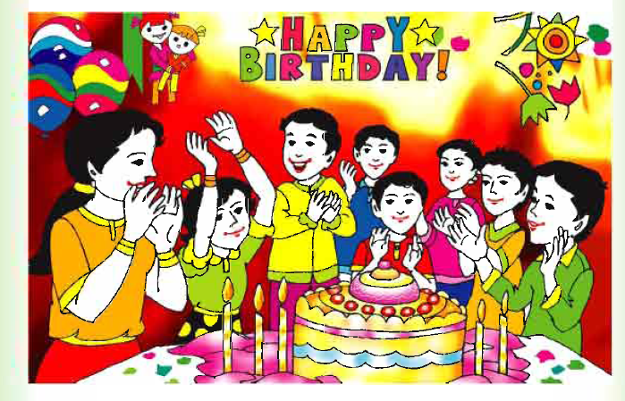
Presentation

Slide 8
No I’ll ask the students some questions about the picture.
1. What do you see the picture?
2. What are they doing?
3. How many candles in the picture?

Slide 9

Birthday
Birthday
Someone born
Anniversary
Wedding anniversary
জন্মদিন

Slide 10


Candles
Enjoy

Slide 11
Memorable
Memorable
Memorable
Unforgettable
Terrific
Remarkable
স্মরণীয়

Slide 12
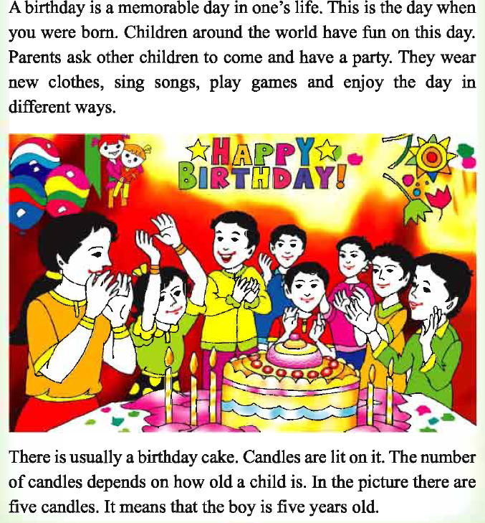
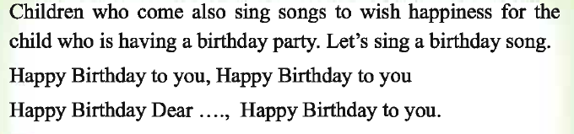
Teacher’s reading

Slide 13
Teacher students reading
Students reading
Ask and answer
Which day the children have a more fun?
What are they doing?
What are they put on?
Where are the candles?
How many candles are in this picture?
Which song are they singing?

Slide 14
Group work
Making group mix with weak and advance students
Students will read the text and discus the lesson in group.
Silent reading

Slide 15
Cheking learning/Task
Students will read the text one by one.
2. Students will say different sentence about birthday.
Home task
When is your birthday?
Write about three sentences about birthday.

Slide 16

Thanks

